Slide 1
Sub-Atomic Particles
Another building block of matter??
Richard Lasky – Summer 2010

Slide 2
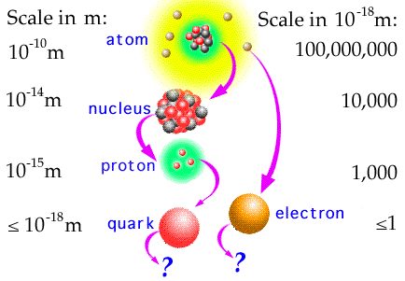
Elementary Particles
Up until 1930 it was thought that we had discovered the basic building blocks of nature
But from 1930 to the present the proton and neutron were found to be made of many more elementary particles

Slide 3
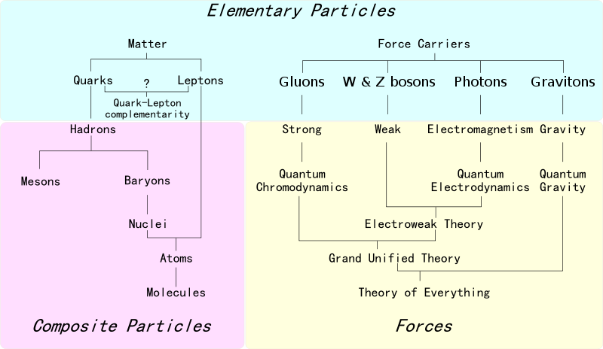
Elementary Particles

Slide 4
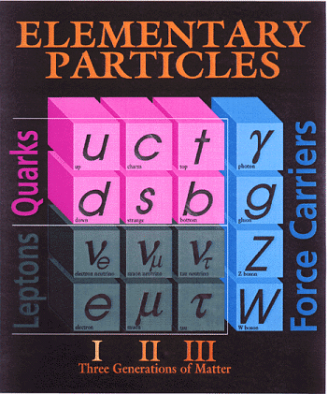
Quarks and Leptons
The two most fundamental types of particles are quarks and leptons
The quarks and leptons are divided into 6 flavors corresponding to three generations of matter
Quarks (and antiquarks) have electric charges in units of 1/3 or 2/3's. Leptons have charges in units of 1 or 0

Slide 5
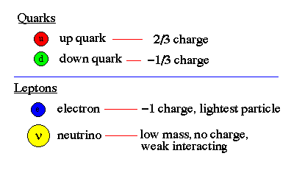
Quarks and Leptons
Normal, everyday matter is of the first generation, so we can concentrate our investigation to up and down quarks, the electron neutrino (often just called the neutrino) and electrons

Slide 6
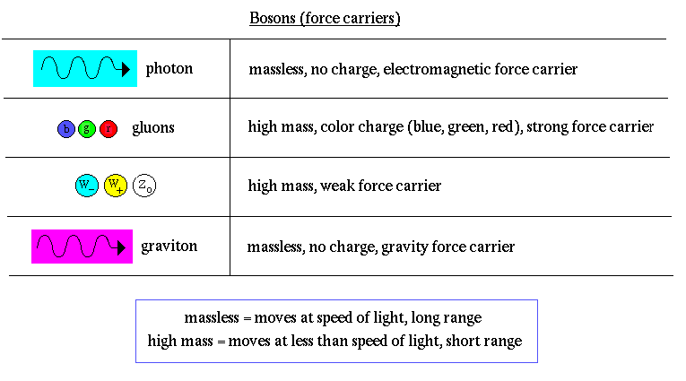
Quarks and Leptons
For every quark or lepton there is a corresponding antiparticle. For example, there is an up antiquark, an anti-electron (called a positron) and an anti-neutrino. Bosons do not have antiparticles since they are force carriers

Slide 7
Baryons and Mesons
Quarks combine to form the basic building blocks of matter, baryons and mesons
Baryons are made of three quarks to form the protons and neutrons of atomic nuclei (and also anti-protons and anti-neutrons)
Mesons, made of quark pairs, are usually found in cosmic rays
The quarks all combine to make charges of -1, 0, or +1.

Slide 8
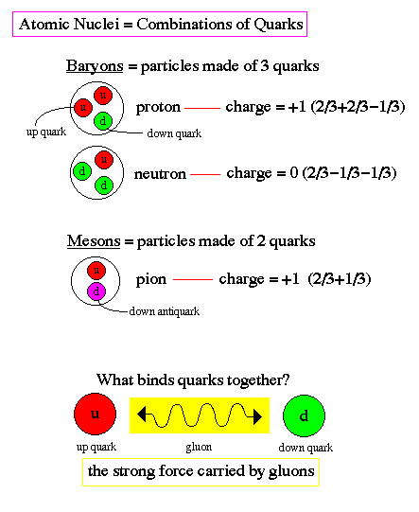
Baryons and Mesons

Slide 9
Current understanding of the structure of the atom
The atom contains a nucleus surrounded by a cloud of negatively charged electrons
The nucleus is composed of neutral neutrons and positively charged protons
The opposite charge of the electron and proton binds the atom together with electromagnetic forces
The protons and neutrons are composed of up and down quarks whose fractional charges (2/3 and -1/3) combine to produce the 0 or +1 charge of the proton and neutron. The nucleus is bound together by the nuclear strong force (that overcomes the electromagnetic repulsion of like-charged protons)

Slide 10
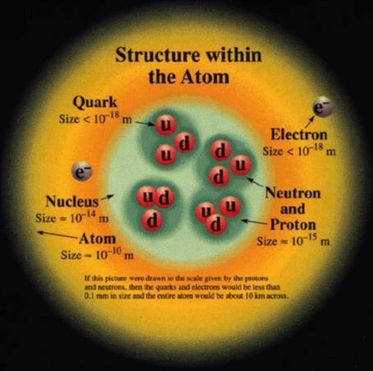
Current understanding of the structure of the atom

Slide 11
Quark Confinement
There can exist no free quarks, i.e. quarks by themselves
All quarks must be bound to another quark or antiquark by the exchange of gluons
The exchange of gluons produces a color force field, referring to the assignment of color charge to quarks, similar to electric charge
The color force field is unusual in that separating the quarks makes the force field stronger (unlike electromagnetic or gravity forces which weaken with distance)
Energy is needed to overcome the color force field
That energy increases until a new quark or antiquark is formed (energy equals mass, E=mc²)

Slide 12
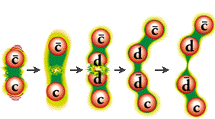
Quark Confinement
Two new quarks form and bind to the old quarks to make two new mesons
Thus, none of the quarks were at anytime in isolation
Quarks always travel in pairs or triplets

Slide 13
Videos
http://www.youtube.com/watch?v=H8ZMmZ_2BnI&feature=relatedVideos
http://www.teachersdomain.org/asset/phy03_vid_quark/
Hot quark soup
Relativistic Heavy Ion Collider
Brookhaven National Laboratory, Upton, N.Y.
http://www.youtube.com/watch?v=kXy5EvYu3fw&feature=player_embedded`

